Slide 1
Wine Quality Prediction using ML
-Adithya S.T.-18MIS1025

Slide 2
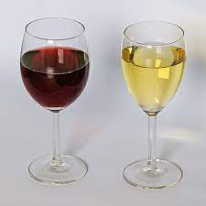
Introduction
About wine:
Wine is a beverage made from fermented grape and other fruit juices with lower amount of alcohol content
Quality of wine is graded based on the taste of wine and vastage. This process is time taking, costly and not efficient.
A wine itself includes different parameters like fixed acidity, volatile acadity, canic acid residual sugar, chlorides, free sulphur dioxide, total sulphur dicaide, density, pit

Slide 3
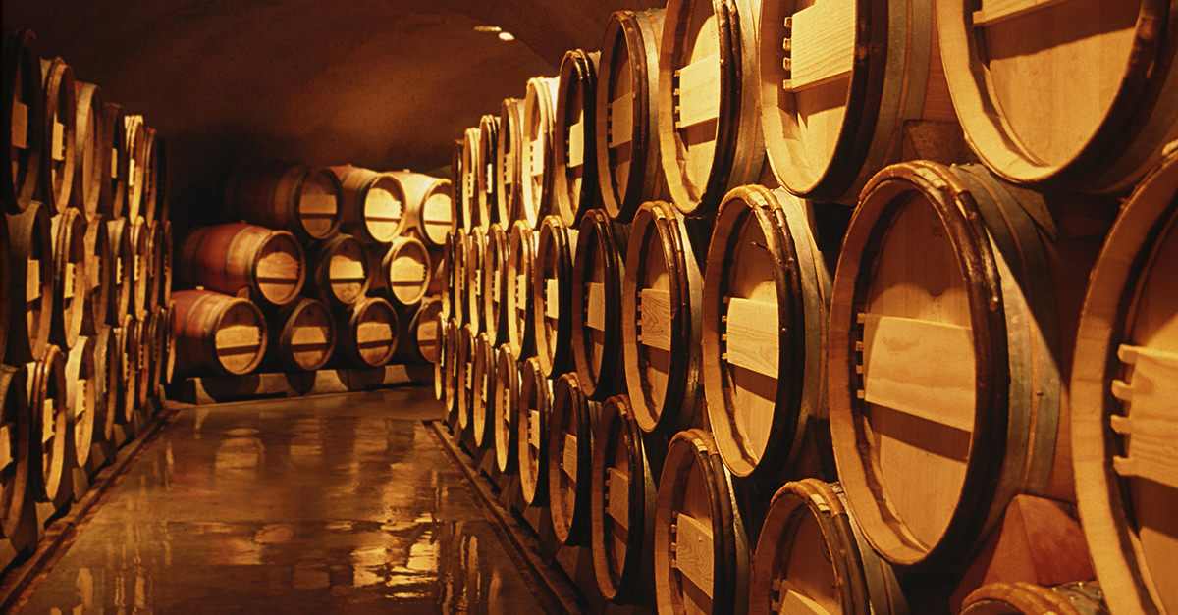
Problem statement
In industries, understanding the demands of wine safety testing can be a complex task for the laboratory with numerous analytes and residues to monitor. But, our application's prediction, provide ideal solutions for the analysis of wine, which will make this whole process efficient and cheaper with less human interaction.

Slide 4
Objective
Our main objective is to predict the wine quality using machine leaming through Python programming language
A large dataset is considered and wine quality is modelled to analyse the quality of wine through different parameters like fixed acidity, volatile acidity etc.
All these parameters will be analysed through Machine Learning algorithms like random forest classifier algorithm which will helps to rate the wine on scale 1 - 10 or bad - good.
Output obtained would further be checked for correctness and model will be optimized accordingly.
It can support the wine expert evaluations and ultimately improve the production.

Slide 5
Proposed Methodology
It gives insights of the dependency of target variables on independent variables using machine learning techniques to determine the quality of wine because it gives the best outcome for the assurance of quality of wine.
The dependent variable is "quality rating" whereas other variables i.e. alcohol, sulphur etc. are assumed to predictors or independent variables.
While hindering the effectiveness of the data model, various types of errors have occurred like over fitting, introduced from having too large of a training set and bias occur due to too small of a test set.

Slide 6
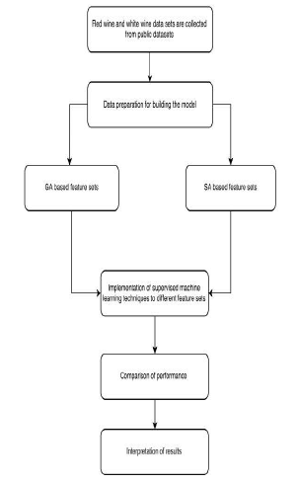
Architectural Model

Slide 7
USE CASE DIAGRAM

Slide 8
SEQUENCE DIAGRAM:

Slide 9
CLASS DIAGRAM:

Slide 10
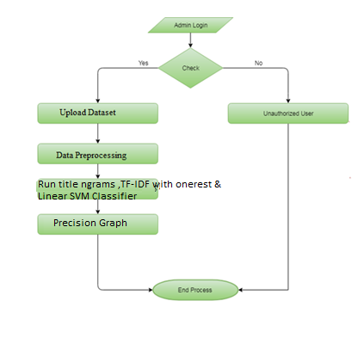
Data Flow diagram :

Slide 11
Component Diagram :

Slide 12
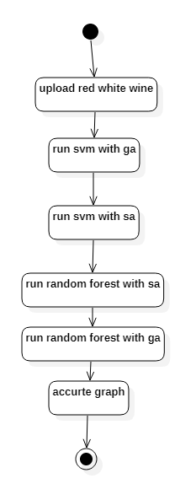
ACTIVITY DIAGRAM:

Slide 13
CLASSIFICATION AND REGRESSION TREE (CART)
CART is a decision tree used for analysing both datasets (red and white wine).
The decision trees produced by CART are always binary, containing exactly two branches for each decision node.
The CART algorithm grows the tree by conducting for each decision node, an exhaustive search of all available variables. All possible splitting values, selecting the optimal split

Slide 14
RANDOM FOREST
Random forest is a method of classification, regression and other tasks, that operate by constructing a multitude of decision trees at training time and outputting the class that is the mode of the classes (classification) or mean prediction (regression) of the individual trees.
Following are some of the features of random forest algorithm:
1. It runs efficiently on large databases.
2. It gives estimates of what variables are important in the classification.
3. It generates an internal unbiased estimate of generalization error as the forest building progresses occur.

Slide 15
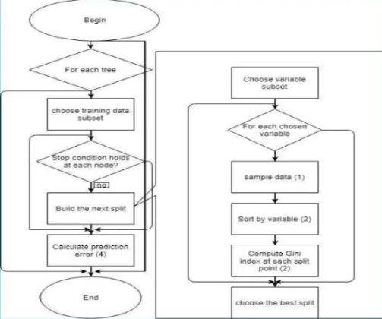
RANDOM FOREST

Slide 16
K-Nearest-Neighbourhood Classifiers
This classifier technique is depended on learning by analogy; this means a comparison between a test tuple with similar training tuples.
The training tuples are described by n attributes. Each tuple corresponds a point in an n dimensional space. All the training tuples are stocked in an n-dimensional pattern space. For an unknown tuple, a k-nearest-neighbourhood classifier searches the pattern space for the k training tuples that are closest to the unknown tuple. k training tuples are called as the k "nearest neighbours" of the unknown tuple.
"Closeness" is a metric distance, likewise Euclidean distance between two points or tuples, say, X₁ = (X11,X12.1n) and X₂ = (x21,X22.. dist (X1, X2)=√√1(x₁1-x2₁)² X2n), is:

Slide 17
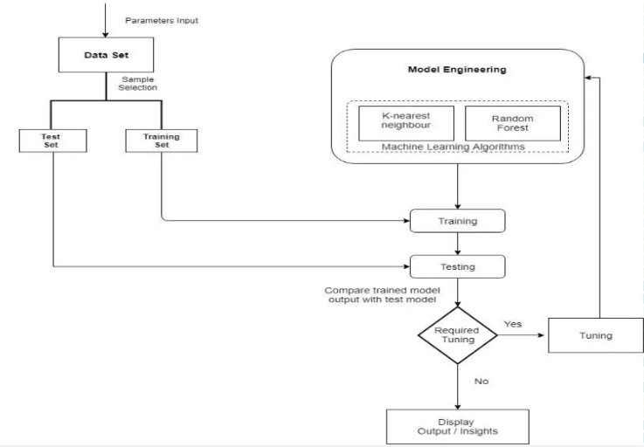
Architecture Model

Slide 18
APPLICATION
Results will be used by the wine manufacturers to improve the quality of the future wines.
Certification bodies can also use the result for quality control.
Results can be used to make wine selection guides for wine magazines.
Results can be used by consumers for wine selection

Slide 19
S. Brin and L. Page. The anatomy of a large-scale hypertextual web search engine. In Proceedings of the 7th International Conference on World Wide Web, 1998.
[1] J. Furnkranz and E. Hullermeier. Preference Learning: A Tutorial Introducton, DS 2011, Espoo, Finland, Oct 2011.
[2] Hsu C W, Chang C C, Lin C J. A practical guide to support vector classification[J]. 2003.
[3] Chang C C, Lin C J. LIBSVM: a library for support vector machines[J]. ACM Transactions on Intelligent Systems and Technology (TIST), 2011, 2(3): 27.
[4] Swingler K. Applying neural networks: a practical guide[M].Morgan Kaufmann, 1996.

Slide 20
[6] M. Cha, H. Haddadi, F. Benevenuto, and K. P. Gummadi. Measuring user influence in twitter: The million follower fallacy. In Proceedings of the 2010 International AAAI Conference on Weblogs and Social Media, 2010.
[7] P. Chen, H. Xie, S. Maslov, and S. Redner. Finding scientific gems with google’s pagerank algorithm. Journal of Informetrics, 1(1), 2007.
[8] D. J. Cook and L. B. Holder. Mining Graph Data. John Wiley & Sons, 2006.
[9] B. S. Demoll and D. Mcfarland. The Art and Science of Dynamic Network Visualization. Journal of Social Structure, Volume 7, 2005.
[10] Y. Ding, E. Yan, A. Frazho, and J. Caverlee. Pagerank for ranking authors in co-citation networks. Journal of the American Society for Information Science and Technology, 60(11), 2009.
[11] G. Dutton. Improving locational specificity of map data - a multi-resolution, metadata-driven approach and notation. International Journal of Geographical Information Science, 10(3), 1996.
[12] D. Easley and J. Kleinberg. Networks, Crowds, and Markets: Reasoning About a Highly Connected World. Cambridge University Press, 2010.

Slide 21


